Slide 1

CLI
BASICS OF COMMAND LINE
Presented By : Sofya and Sabina
Apec PetroTechnic

Slide 2
1
OUTLINE
Introduction to CLI
Directory Navigation in CLI
Operating Systems in CLI
Practical Task
Advantages of Using CLI
Conclusion

Slide 3
2
INTRODUCTION TO CLI
What is CLI?
CLI is a text-based interface that allows users to interact with an operating system or software by typing specific commands.CLI is widely used by developers, system administrators, and power users.
Why is it important?
CLI is important because it enables fast task execution, automation, advanced system control, remote management, and efficient resource usage.

Slide 4
Os systems
Many operating systems provide a Command Line Interface (CLI) as a way to interact with the system.
LINUX
MAC
WINDOWS

Slide 5
3
ADVANTAGES OF USING CLI
Speed
Flexibility
Faster than graphical interfaces for many tasks.
Access advanced features and tools.
Efficiency
Remote Access
Automate tasks with scripts.
Manage systems remotely.

Slide 6
4
DIRECTORY NAVIGATION IN CLI
01
Navigating the File System
02
Creating and Deleting Folders
cd – change directory.
pwd – Display the current directory path.
ls/dir – Show files and subdirectories.
mkdir - Create a new directory.
rmdir - Delete an empty directory.
rm - Delete a directory and its files.
03
Working with Files
touch (Linux) / echo > file.txt (Windows) – create a file.
rm / del – delete a file.
mv – move or rename a file.
cp – copy files and directories.

Slide 7
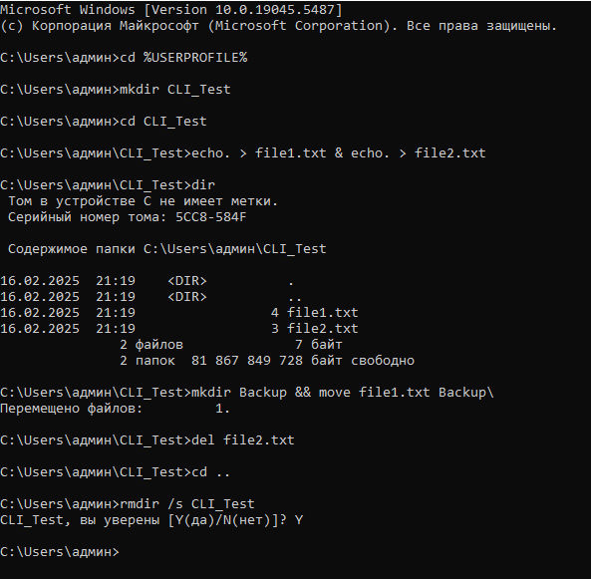
PRACTICAL TASK
This task provides hands-on experience with basic command-line operations, which are essential for file and directory management. By completing these steps, users will:
Learn how to navigate the file system using CLI commands.
Create and manage directories and files.
Perform file operations such as moving and deleting files.

Slide 8
4
PROBLEM
First Problem
Issue involved a Kingston USB flash drive, which became unreadable after incorrect formatting and file deletions. These challenges required troubleshooting and step-by-step solutions to restore functionality.
The flash drive was improperly formatted, and some files (e.g., thumb.db) could not be deleted manually.
Larana University | 2024
Second Problem
After formatting, the USB drive became unreadable on the new computer, displaying the error: "The file or directory is corrupted and unreadable."

Slide 9
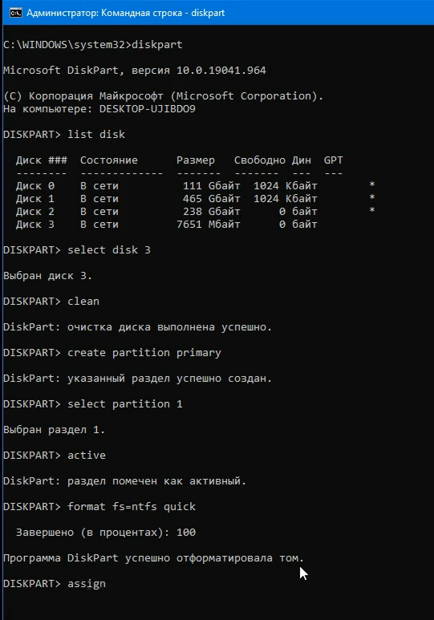
5
MY EXPERIENCE
1
Used list disks to check for the drives to be detected.
Larana University | 2024
2
Creating new partition
3
Reformatted the USB drive with ntfs or format for better compatibility.

Slide 10

8
CONCLUSION
In conclusion, mastering the Command Line Interface (CLI) is essential for efficient system navigation, file management, and automation of repetitive tasks. The CLI provides greater control over the operating system, allowing users to perform tasks more quickly than using a graphical interface.

Slide 11

THANK YOU

